Slide 1
New Requirements for Time-Engineered Holographic Teleportation Over Internet
Ning Wang
University of Surrey

Slide 2
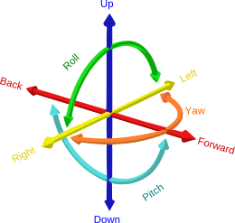

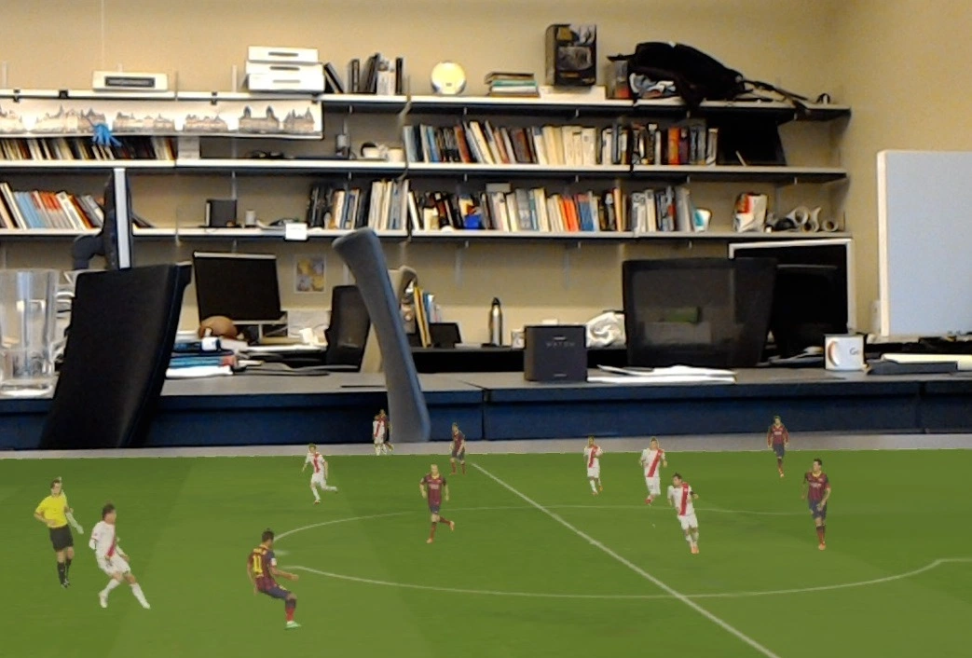
Application Background
3D reconstruction of dynamic scenes in real-time.
Object-based content
Dedicated selection of specific objects (with or without background)
6-Degree of Freedom (6DoF)
Applications: gaming, tourism, construction, military, education, remote surgery etc. (Anything that you can imagine of and makes sense of an AR app)

Slide 3
Understanding User QoE in Holographic Teleportation
Image quality
“Noises” at the boundary of teleported object
No adaptation in terms of quality (unlike DASH video content)
Frame rate
Determined by the hardware of the sensor camera capacity – typically 30 FPS (frame per second) or 60FPS
Network requirements → ~50-70Mbps per teleported object (with HMD), much higher for the scenario with naked eyes
Play-back latency
Data synchronization
Important for multi-source teleportation
To be explained later

Slide 4
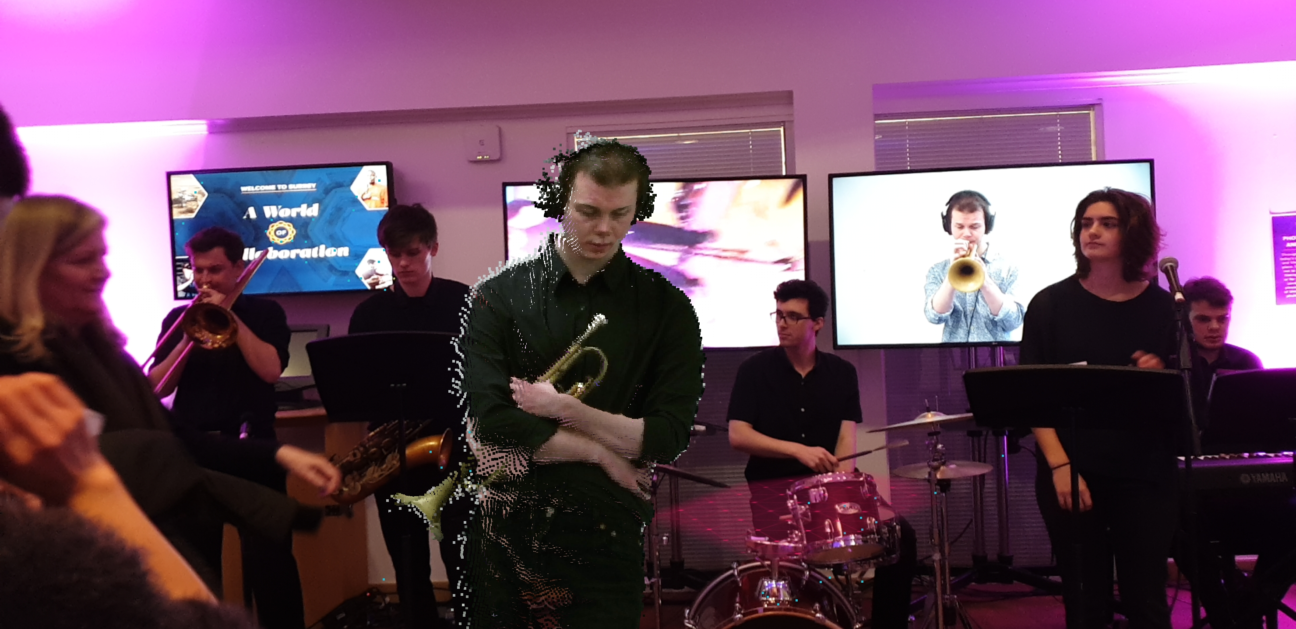


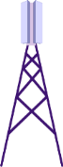



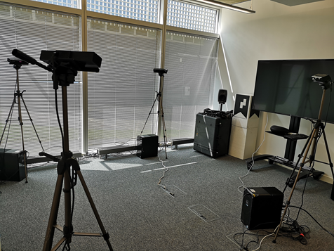
High-level overview of Holographic Teleportation System
Local processing
of raw data
Production
Server
function
Sensor
cameras
Teleported
object
Client
Consumer/
User equipment (UE)
Synchronisation of frames originated from each client
Frame rendering / production
Kinect Sensor Cameras

Slide 5
A General Scenario
Whoever can access the production server is able to manipulate the teleported objects/scenes individually
Source 1
Aggregation
Point
UE
Source 2
Synchronisation of incoming frames from different sources
Merging of frames synchronised
Source 3

Slide 6
Requirements on Time Engineering
Single object source scenario
Time engineering requirements: Frames with the same production time should arrive at the UE side at the same time
Good news
Frames produced from multiple local clients are typically delivered via the common paths, reduced the risk of network uncertainty
Aggregation
Point
UE

Slide 7
Requirements on Time Engineering
Multi-object source scenario
Time engineering requirements: Frames with the same production time at different sites should arrive at the UE side at the same time
More challenging
Frames produced from multiple objects/sits are typically delivered via different paths with specific network latency, increased challenge on time engineering across multiple sources
Aggregation
Point
Australia
UE
North
America
Europe
Asia

Slide 8

Supporting Multi-source Teleportation
Decoupling (in-network) synchronisation from (edge-based) frame merging/production
Synchronisation
buffer
…
In-network Synchronisation function
…
Edge-based production function
Key benefits:
Relieve the buffering load at the production server side for buffering incoming frames with substantial delay variations across all Internet locations
Bandwidth saving – early drop of out-of-synchronisation frames along the “reverse” tree

Slide 9
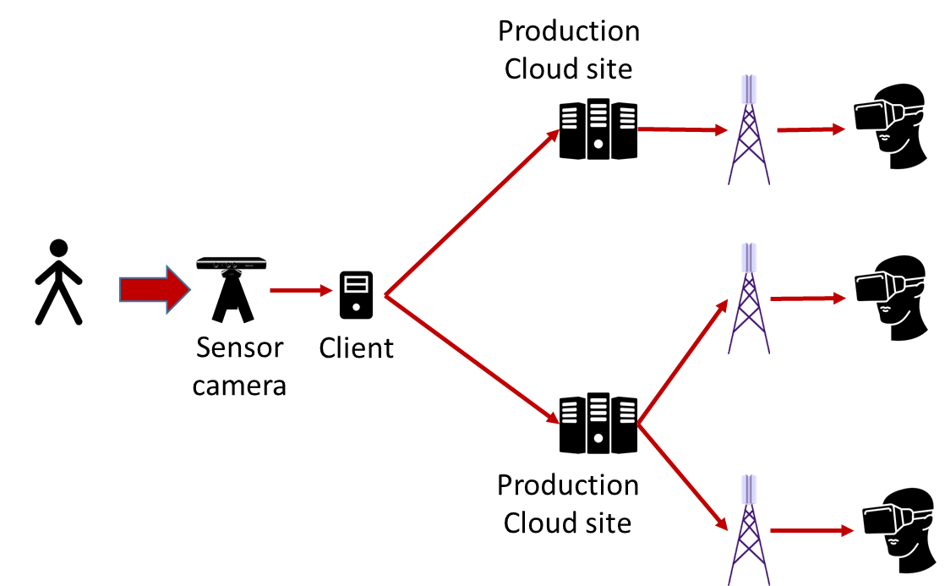
Multicast/Broadcast
Key challenges
The client on the source side needs to respond to the incoming frame requests from different production cloud sites
Variation of playback delay at different receiver locations
Optimized selection of production cloud sites according to the locations of receivers

Slide 10
Technical Challenges on the Transport Layer
Congestion control for high-data rate and time engineering requirements
Coordination between two (or more) path segments at the transport layer in order to achieve end-to-end time precision
Aggregation
Point
UE
Coordination
More fundamentally…
Revisiting design principles for unicast vs. multicast/broadcast
Any new requirements on the transport-layer for such new application model of “(synchronized reverse-multicast” (many-to-one) and even “X-shape-cast” (many-to-many)

Slide 11
Technical Challenges on Network Layer
New layer-3 network model/protocols for supporting such emerging applications beyond unicast, multicast, broadcast and anycast?
Any Source Multicast (ASM) supports multipoint-to-multipoint, but a) it is based on one single RP, and b) it does not support synchronization
Even IP multicast has not yet seen its bright future up to now ☹
In-network data synchronization as a new network element capability
Extension of router-level data caching/buffering functions to synchronization with time precision objectives
State maintenance scalability
Data in
(Synchronised)
Data out
Data in
Data out
ICN caching: blind, LRU/LFU…
Buffering: onward path conditions
Synchronisation requirements
Context information about other incoming data?

Slide 12
Overview on Key Research Questions
Simultaneous tackling of high-bandwidth and time engineering issues
Extension to holographic content aware/centric network?
A new network model beyond unicast, multicast and broadcast – multipoint-to (multi)point with stringent data synchronization requirements?
A cross-layer approach?
Application-layer at the edge
“Horizontal” coordination between transport-layer at different path segments → new transport?
Network-layer in the middle (in-network synchronization)

Slide 13

Thank You!

